Slide 1
Function Points – Measurement parameters
Most of the operations and data files have been considered of simple or medium complexity.
Criteria used:
Internal / External logical files
SIMPLE
Few basic fields
Not related with other data structures
Example: User, Taxi.
MEDIUM
Many fields, possibly critical
Non basic data structures (e.g. graphs)
Example: Rides, City Zones
External input / output / inquiries
SIMPLE
Basic functionalities
Little or no data processing
Example: Login, Logout.
MEDIUM
More data processing or data retrival
May involve multiple type of data
Example: Request a taxi, Visualize the rides history.

Slide 2
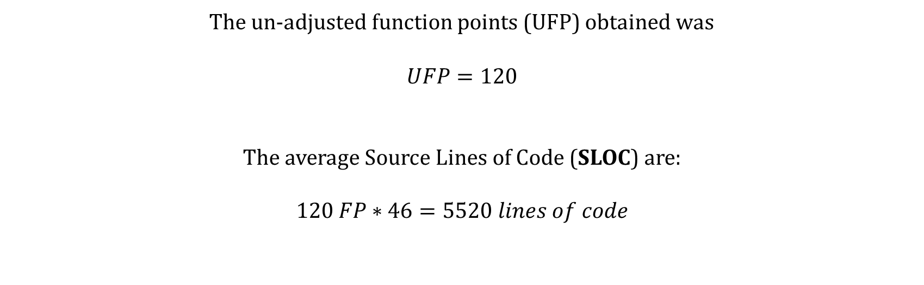
Function Points
The un-adjusted function points (UFP) obtained was
$$UFP=120$$
The average Source Lines of Code (SLOC) are:
$$120 FP∗46=5520 lines of code$$

Slide 3
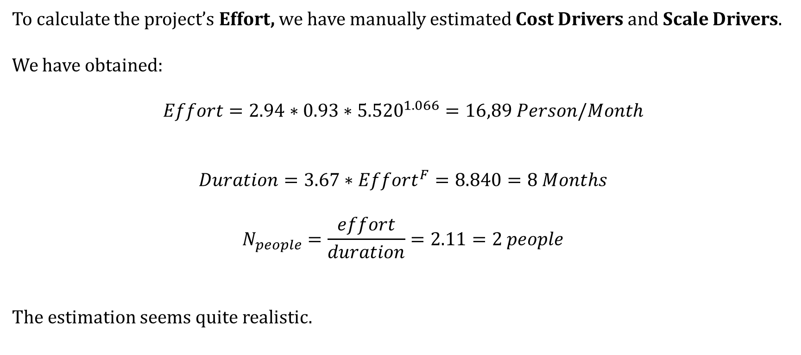
COCOMO
To calculate the project’s Effort, we have manually estimated Cost Drivers and Scale Drivers.
We have obtained:
$$Effort=2.94∗0.93∗{5.520}^{1.066}=16,89 Person/Month$$
$$Duration=3.67∗Effort^{F}=8.840=8 Months$$
$$N_{people}=\frac{effort}{duration}=2.11=2 people$$
The estimation seems quite realistic.

